Slide 1
Network Eavesdropping
Jalaj Limaye
Assistant Professor
Vishwakarma University

Slide 2
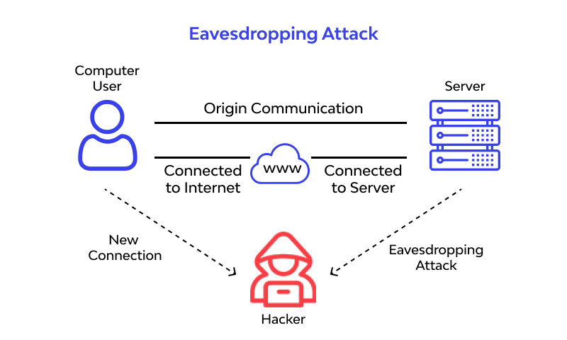
Network Eavesdropping
Network eavesdropping involves attackers intercepting network traffic to steal sensitive data.
Goals include credential theft, sensitive data theft (e.g., bank account details), and session hijacking.
Attackers may install monitoring hardware/software or create unreliable networks like public Wi-Fi.
Effective countermeasures include robust authentication and encryption mechanisms.
Access control using security protocols helps prevent data leakage and enhances overall network security.

Slide 3
Mitigating network eavesdropping requires a multi-faceted approach:
Awareness:
Promoting information security awareness among IT professionals and organizations is crucial to address vulnerabilities. Users should exercise caution when connecting to public Wi-Fi networks, ensuring strong encryption is in use.
Encryption:
Strong encryption is the best defense against eavesdropping. However, it's not infallible due to advancements in computing power and performance constraints of some applications.
Network Segmentation:
Proper segmentation of networks limits access, reducing the potential impact of eavesdropping attacks. This ensures that devices only have access to relevant network resources.

Slide 4
Mitigating network eavesdropping requires a multi-faceted approach:
Network Access Control (NAC):
Implementing NAC prevents unauthorized access to the network, making eavesdropping significantly more difficult for attackers. It ensures that only trusted devices have full network connectivity.
Physical Security:
Ensuring physical security measures are in place is essential to prevent unauthorized access to network points, such as those in meeting rooms or lobbies, which could be exploited by attackers for eavesdropping or other malicious activities.

Slide 5
Protection from network eavesdropping attack
Control network eavesdropping by activating RADIUS authentication and encrypting data with TKIP using WEP 128-bit encryption.
Security protocols, like RADIUS and EAP, divide the network into authentication server, authenticator, and supplicant, ensuring secure communication between wireless devices and servers.
RADIUS server in EAP authentication acts as a secondary layer of protection, enhancing security. EAP facilitates user-based authentication, providing enterprise-level security to the network.
Utilize Protected EAP with MS-CHAP authentication for increased security. Additionally, regularly check for signal leaks outside the building and adjust transmitter power to reduce leakage.
Notes:
The on-premise or Cloud RADIUS servers act as the “security guard” of the network; as users connect to the network, the RADIUS authenticates their identity and authorizes them for network use.
The most widely used wireless network protocols today are the Extensible Authentication Protocols (EAP) used in WPA2-Enterprise. Utilizing an EAP authentication method ensures that users’ information is sent over-the-air using encryption and avoids interception.

